Slide 1
Food Tourism:
Identifying the culinary experience

Slide 2
Problem
Food tourism is a growing industry
People like to travel for the culinary experiences
Foursquare can help to identify the next travel destination

Slide 3
Data acquisition and cleaning
Get restaurants from Foursquare
Up to 50 restaurants per query
Communication via JSON
1km around the city center

Slide 4
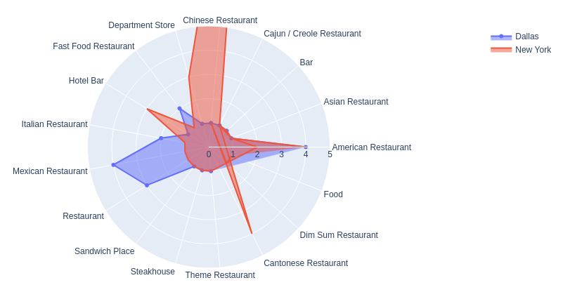
Exploratory Data Analysis
Image 1: Distribution of restaurants per city.

Slide 5
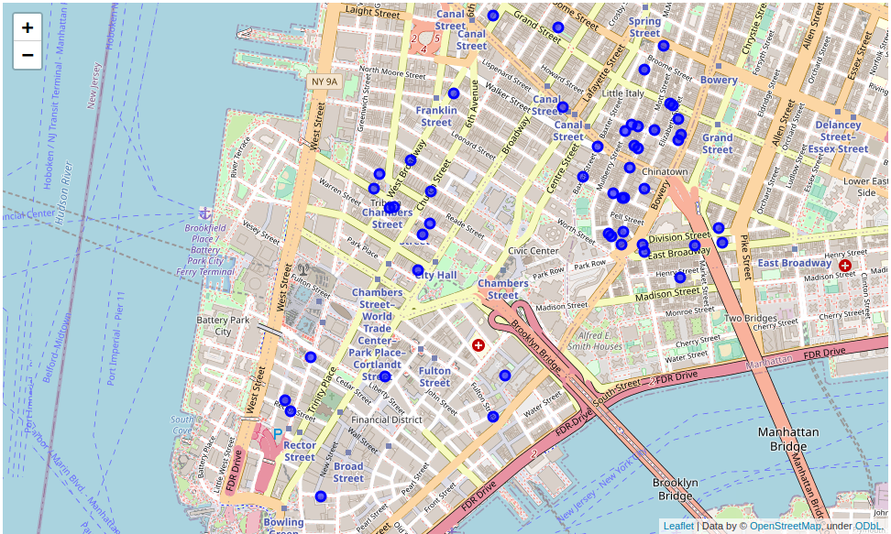
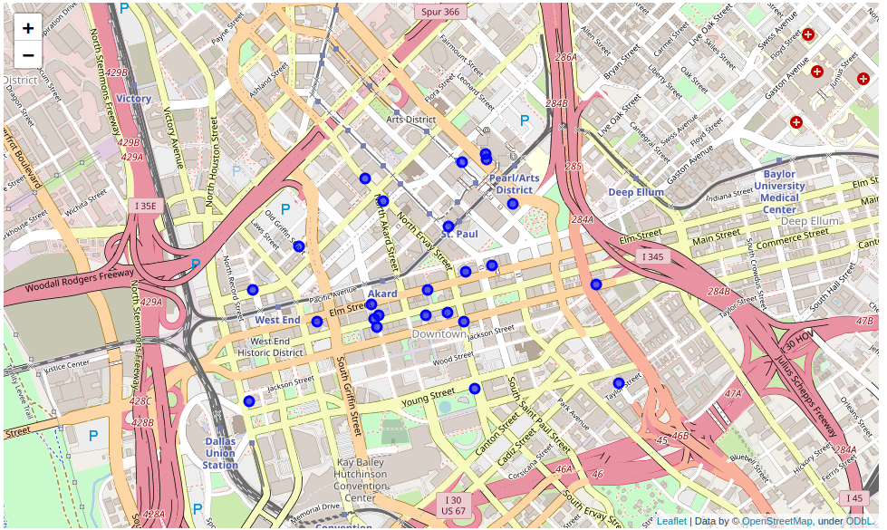
Exploratory Data Analysis
Image 2: Location of restaurants around New York city center.
Image 3: Location of restaurants around Dallas city center.

Slide 6
Results
It is possible to appreciate a large number of Chinese restaurants in NY, while Dallas has a larger number of Mexican restaurants.
The location distribution of the restaurants if both cities is different. On one side, NY is a very dense area, while in Dallas the restaurants are more distanced.
There are more restaurants in the city center in NY than in Dallas.
There are more variety of Food in NY than in Dallas.

Slide 7
Conclusion
New York is a more attractive city for doing this kind of food tourism, since there are plenty of restaurants in a walking distance from each other. To do the same kind of tourism in Dallas, it is required to use a car.

